Slide 1

Mercenfeld
Phonic Screening Check

Slide 2


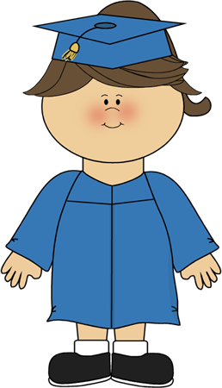
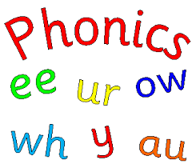
Year 1 and Year 2 Re-take
Phonics Screening Check
Week Beginning 8th June 2020

Slide 3

What is Phonics?
Letters and Sounds was introduced by The Department for Education and skills in 2007
Phonics is fun way to teach children to read and write quickly and skilfully.
Children are taught how to:
recognise the phonemes (sounds) that each individual letter makes;
identify the phonemes (sounds) that different combinations of letters make - such as ‘sh’ or ‘oo’;
blend phonemes together from left to right when reading
segment the phonemes when spelling
chapter
menu
next page

Slide 4
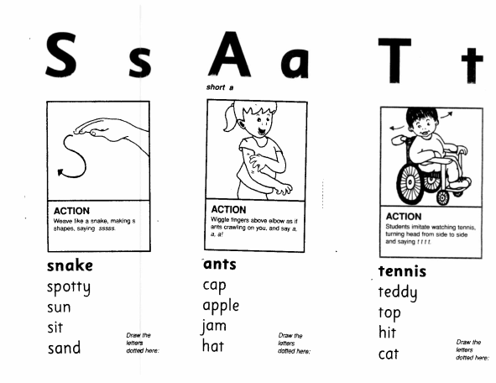
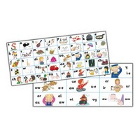
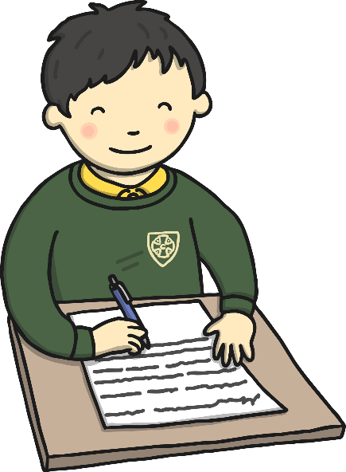
Phonics at Mercenfeld
Children have a 20-25 minute daily differentiated phonics lesson with opportunities to apply their phonic knowledge in lessons and phonic game times.
We use Ruth Miskin resources with Letters and Sounds.
chapter
menu
next page

Slide 5
What is the Phonics Screening Check?
Every Year 1 child in the country will be taking the statutory phonics screening check in the week beginning 8th June 2020
Year 2 children that did not pass the test last year will re-take the new test this year
Some children will be withdrawn from the check if the class teacher and Mrs Shephard feels it is appropriate to do so
The check is very similar to tasks the children already complete during phonics lessons
The focus of the check is to provide evidence of children’s decoding and blending skills, not to test their vocabulary
chapter
menu
next page

Slide 6

What Happens During the Test?
Each child will be asked to ‘sound out’ and blend the phonemes together to make a word e.g. chip- ch-i-p chip
They will be marked on how they pronounce the word after blending the phonemes
The check will consist of 40 words in total; 20 real words and 20 pseudo words (alien words)
The pseudo words (alien words) are to assess their phonic decoding skills
Each check will take between 4 and 9 minutes to complete
The pass mark will not be published until after the screening
(2018/2019 test- 32 or more out of 40 was a pass)
chapter
menu
next page

Slide 7

Pseudo Words (Nonsense words)
The pseudo words will be shown to your child with a picture of an alien. This provides the children with a context for the pseudo word which is independent from any existing vocabulary they may have. Pseudo words are included because they will be new to all pupils; they do not favour children with a good vocabulary knowledge or visual memory of words.
chapter
menu
next page

Slide 8
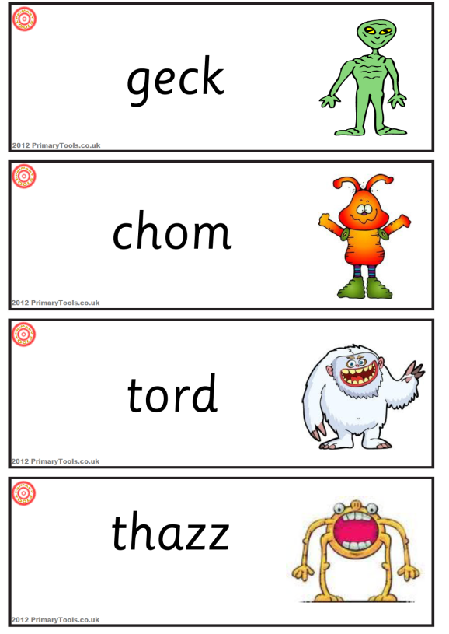
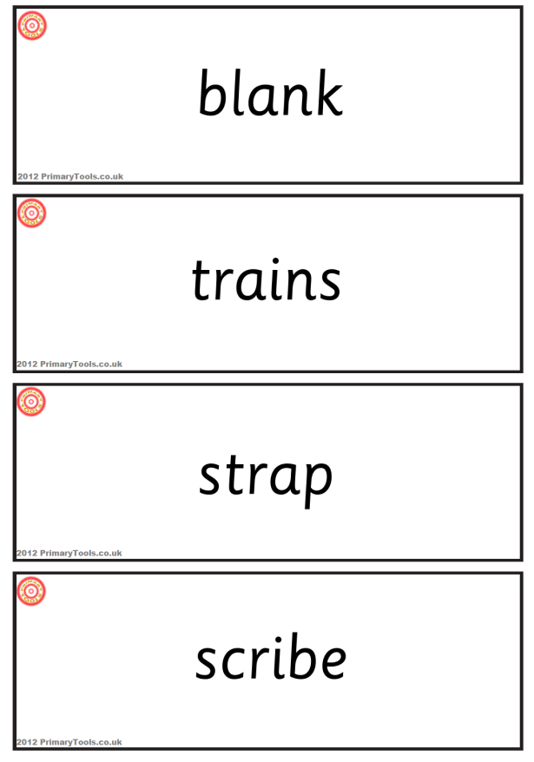
Examples of words

Slide 9
How will it be administered?
All of the screening checks will be administered by a member of Mercenfeld staff
The children will complete the check one to one in the library or intervention rooms
The screening will be taken over the week beginning 8th June 2020
Children are not told at the time whether they have correctly blended the word
chapter
menu
next page

Slide 10

Reporting to Parents
We will inform you of whether your child has passed or fallen below the standard through your child’s school report
If your child’s score falls below the national standard they will re-take the Phonics Screening Check in Year 2
Children who have not reached this level will receive extra support to ensure they can improve their decoding skills before they retake the test the following year
chapter
menu
next page

Slide 11
How Can I Help My Child At Home?
Encourage your child to blend the sounds when reading real or alien words
Practise their sounds and use their spelling books to focus on reading the different phonemes
Practise their phonics by playing games online
Buried Treasure/ Picnic on Pluto
www.phonicsplay.co.uk (phase 3,4,5 and 6)
chapter
menu
next page

Slide 12
How Can I Help My Child At Home?
Encourage your child to ‘sound out’ when reading or writing. Focusing particularly on spotting more unusual sound patterns.
E.g. Digraph- 2 letters making one sound
cow
Trigraphs- 3 letters making one sound
night
Split digraphs- 2 vowels with a consonant in between.
spine - i_e
chapter
menu
next page

