Slide 1
Reading- Parent’s afternoon

Slide 2
The Importance of reading
Benefits of shared reading include with your child helps them to:
Be exposed to rich language
develop listening skills
develop spelling
develop reading comprehension and vocabulary
establish essential foundational literacy skills.

Slide 3
Key facts
◾England's children have less positive attitudes towards reading than in many other countries: only 26% of 10 year-olds 'like reading' compared to 46% in Portugal.
◾Children who read books often at age 10 and more than once a week at age 16 gain higher results in maths, vocabulary and spelling tests at age 16 than those who read less regularly

Slide 5
The skills of reading
Word reading – we teach children how to use phonics and how to read different words so they can understand what they have read.
Comprehension – children need to understand what they have read and they will be taught different skills such as:
Retrieval
Inference
How to understand new vocabulary
How to summarise.
How to predict

Slide 6
Reading to your child
Make it fun
Possibly use puppets
Talk about the book
Link it with your life
Link it to other books
Enjoy it
Make it part of a routine
Encourage other family members to read to children
Reading to the children helps them to learn lots of new words, develop vocabulary, develop imagination and have fun

Slide 7
Reading with your child
If there are pictures, get the children to engage with the pictures and talk about what they are telling you.
Encourage the children to use their sounds and words to read the text but it is important that if a child hasn’t bean able to read the word we read the word to them.
Ask the children questions about the text. Look at key questions on the book mark.
Encourage your child and praise them for their efforts.

Slide 8
Questions to ask your child whilst reading
What has happened so far? Is it what you expected to happen?
What does X word mean?
Give meaning to the word X in this sentence.
What might happen next?
Name three things you’re told about X
Who is your least/favourite character? Why?
How can you tell that…?
What impressions of …….. do you get from this paragraph or chapter?
Find 2 sentences, which describe the setting.
Is the plot fast or slow moving? Find some evidence in the text which supports your view.

Slide 9
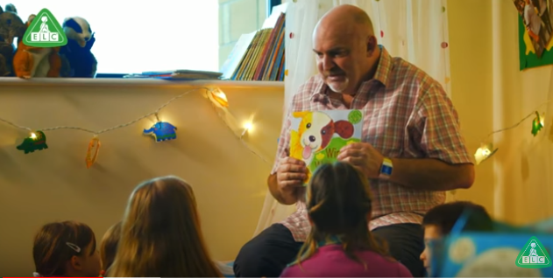
Reading with your child
https://www.youtube.com/watch?v=DrVOtUL-bKM

Slide 10
What can you read to your child / with your child
School books
Magazines
Books that take their interest
Books on kindle
Leaflets
Maps
Comics
Instructions to games and recipes
Blurbs about games
100 top books

Slide 11
Suggested activities to develop your child’s reading.
Read a book and take a picture then tweet it to the author
Visit a local library
Research the meaning of new words the children have found together
Consider books as birthday and Christmas presents
Take books on trips with you that link with what you are doing – eg take a seaside book with you on the trip to the seaside.

Slide 12
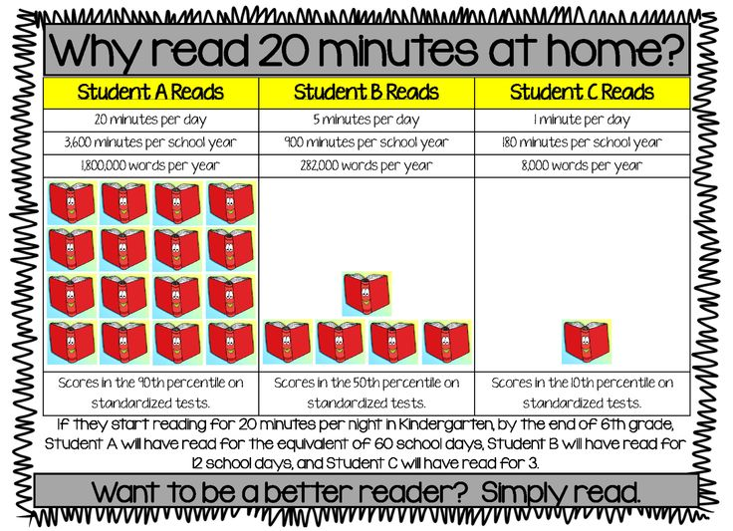
10 minute promise
Teacher to read to children for at least 10 minutes each day.
Children to read to an adult or adult read to their child for 10 minutes each day.

Slide 13
Useful resources
Lovereading4kids.co.uk
Leicestershire Digital Library Services
Booktrust.org.uk
Oxfordowl.co.uk
Neil Griffiths – website, twitter
Mercenfeld School library- encourage your child to change their library book frequently.

